Slide 1
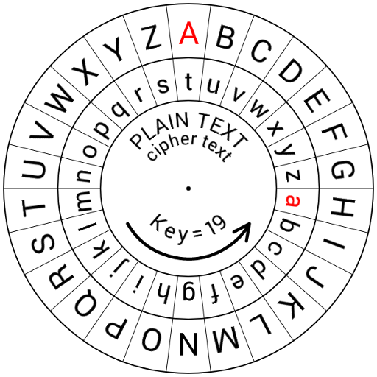
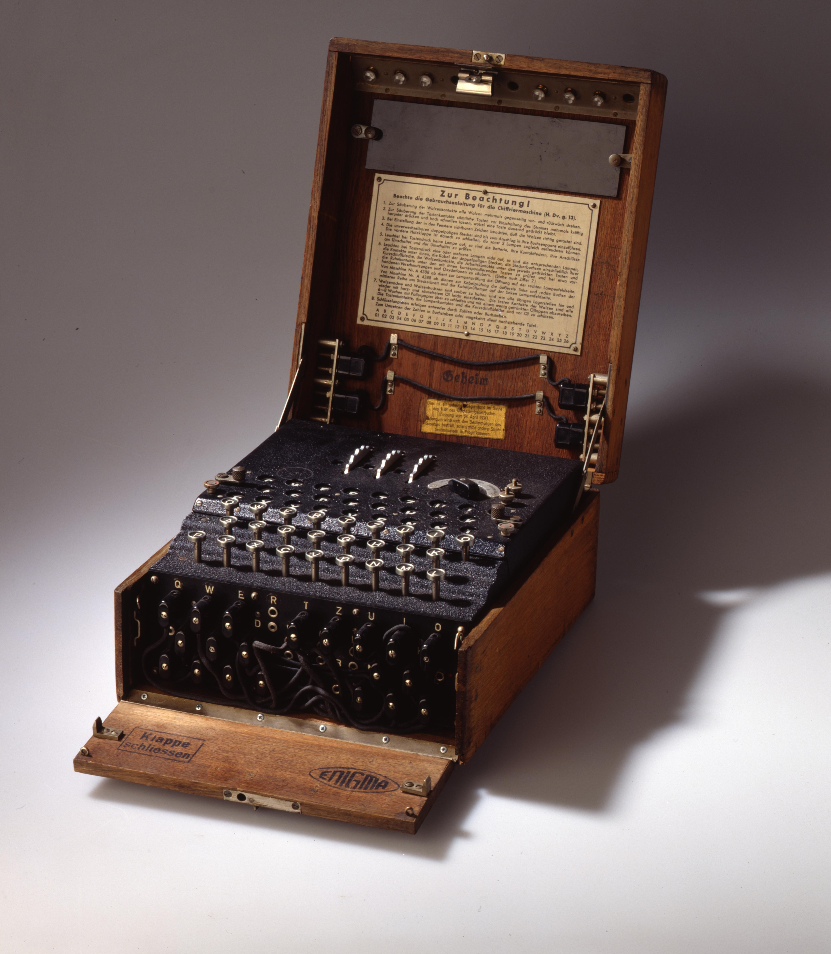
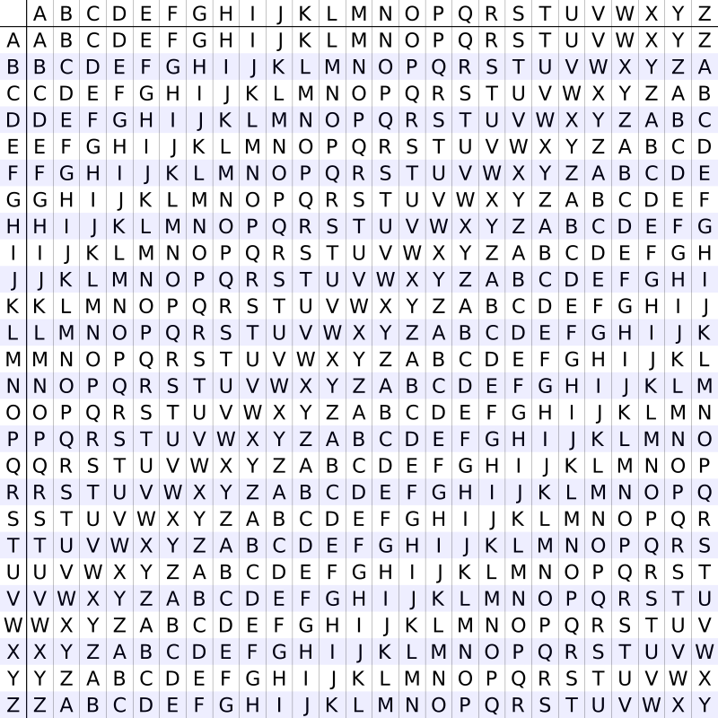
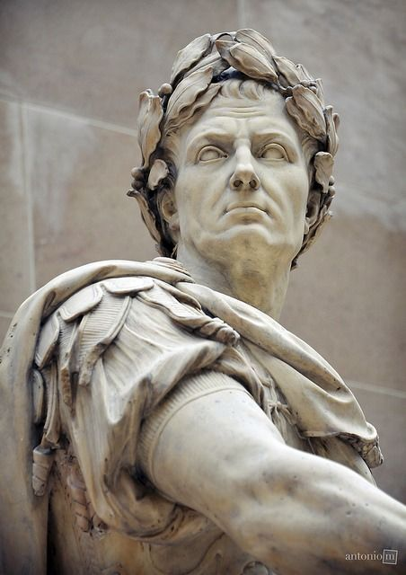
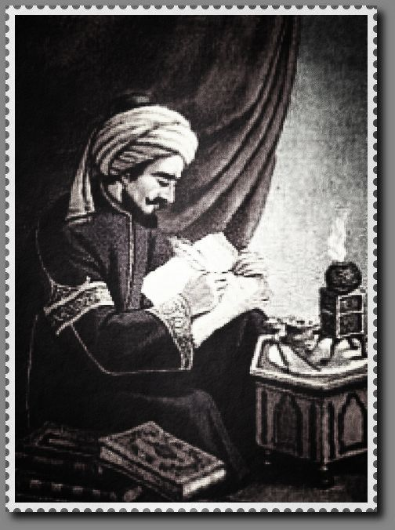
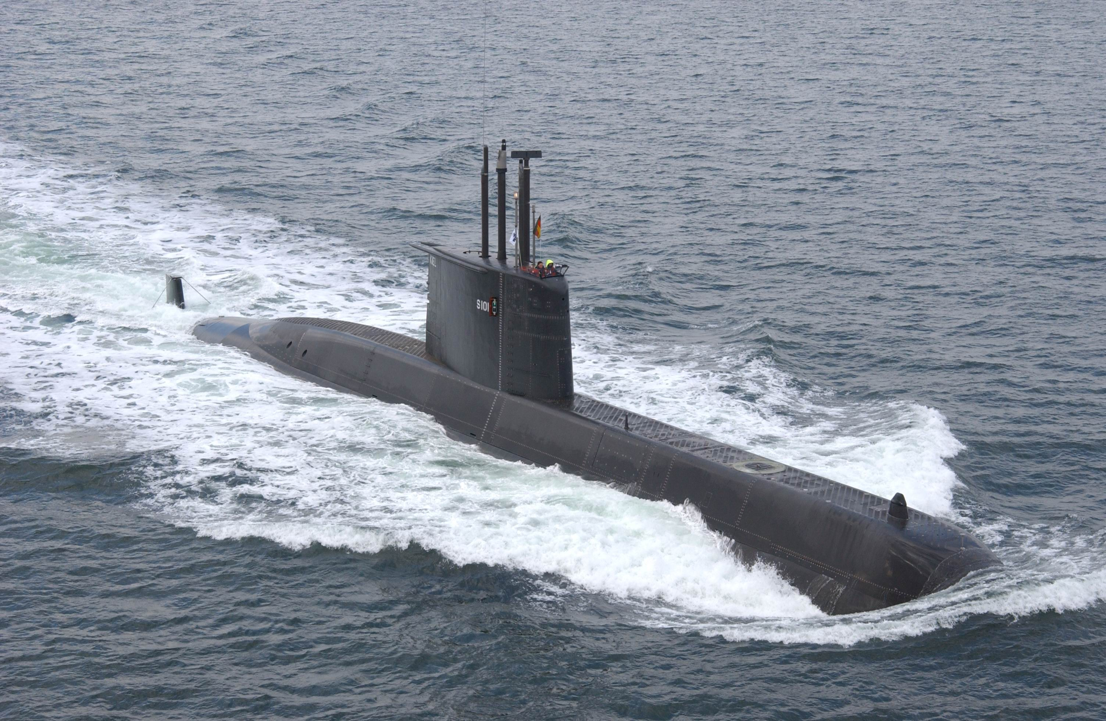
Cryptography
guvfvfnarknzcyrgrkggbqrzbafgengrnprnfnepvcurevubcrlbhjvyyrawblguvfjngpu

Slide 2
What we will see:
Past of cryptography
Antique and Julius Caesar
Middle Ages, Vigenère, Al Kindi and letter frequency fingerprints
WW I and the Zimermann telegram
WW II, Nazis, the Enigma and how they screwed up
Cold war, Shannon and walnuts
Presence of cryptography
Open keys, asynchronous encryption and TLS
Future of cryptography
Breakthroughs in Mathematics and quantum computers

Slide 3
What I hope you‘ll learn:
Cryptography didn‘t fall from the sky but evolved over the course of human history
Difference synchronous vs asynchronous encryption
The world might look quite different today if the Germans had used better encryption techniques.

Slide 4
Ceasar cipher
Each letter is converted into a number A=1, B=2,...,Z=26
On each number the key/shift is added
New number is reconverted into a letter
Example with a shift of 5:
A->1
1+5=6
6->F
Substract the shift to decipher:
F->6
6-5=1
1->A

Slide 5
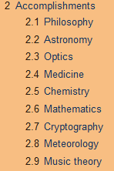
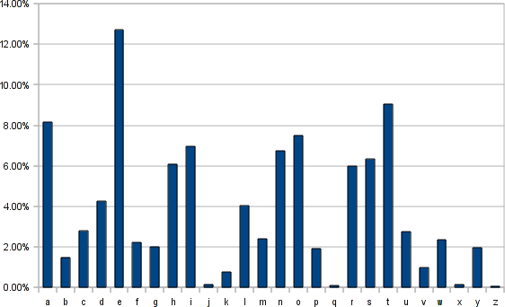
Al Kindi 801 - 873 AD
Cryptoanalysis
Letter frequency analysis
Letter frequency fingerprint

Slide 6
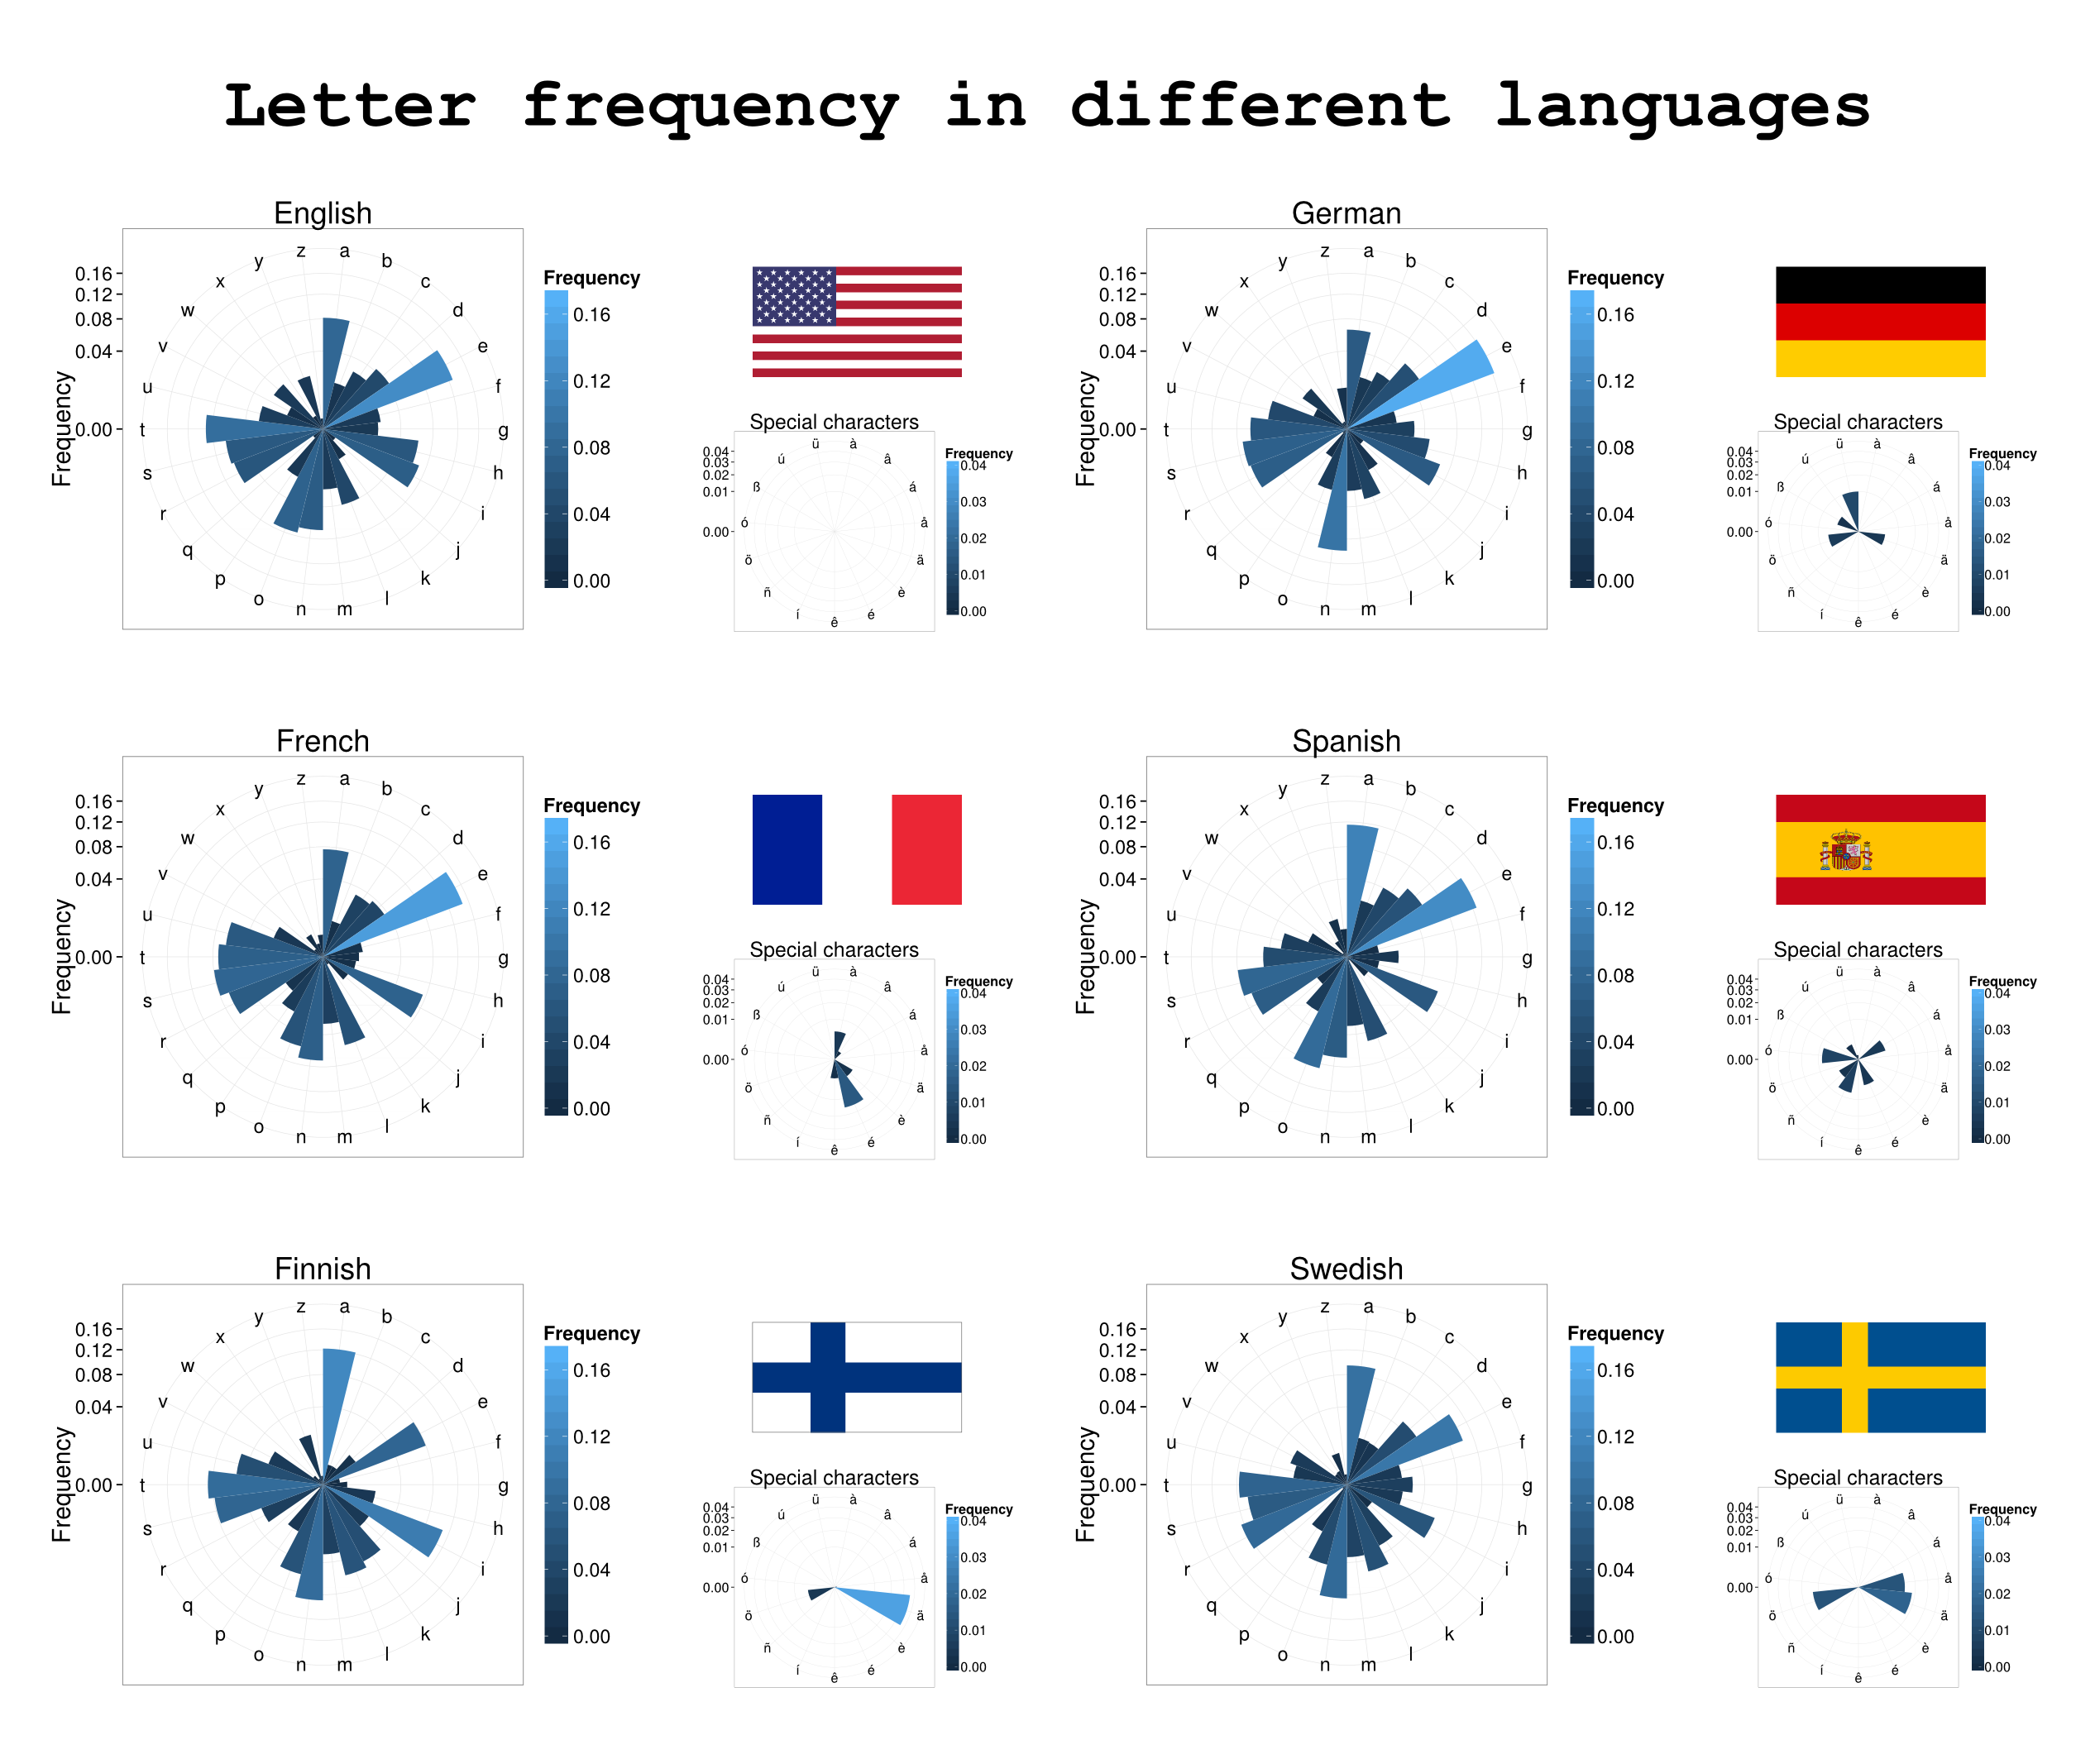

Slide 7
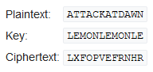
Vigenère cipher – le chiffre indéchiffrable
A new ceasar cipher for each letter
Sequence of shift is given by a keyword

Slide 8
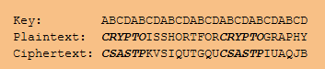

Breaking the unbreakable
Figure out the length of the keyword:
Look for the distance of repeating elements
18=1*2*3*3 =>{1,2,3,6,9,18} 30=1*2*3*5 =>{1,2,3,5,6,10,15,30}
Key.length => {1,2,3,6}
Group cipher elements for their position relative to the keyword
Treat each text sample as a ceasar cipher
18
30

Slide 9
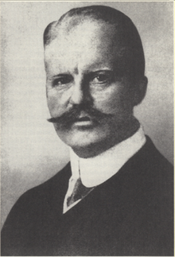
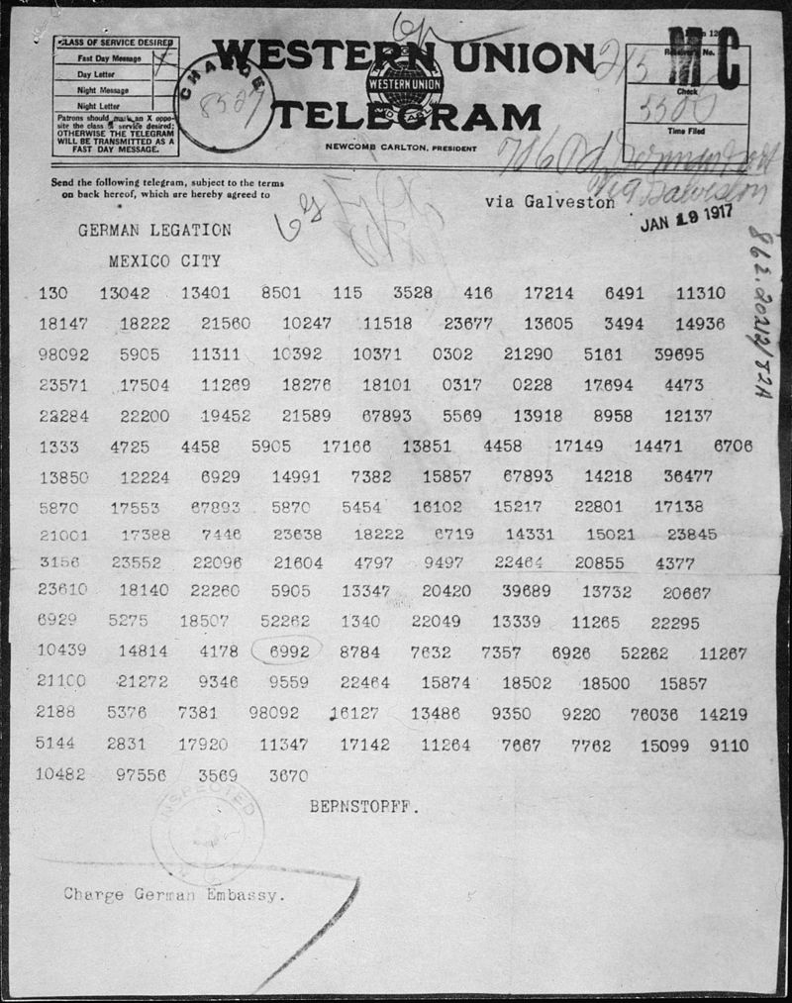
WW I and the Zimmermann telegram
We intend to begin on the first of February unrestricted submarine warfare. We shall endeavor in spite of this to keep the United States of America neutral. In the event of this not succeeding, we make Mexico a proposal of alliance on the following basis: make war together, make peace together, generous financial support and an understanding on our part that Mexico is to reconquer the lost territory in Texas, New Mexico, and Arizona. The settlement in detail is left to you. You will inform the President of the above most secretly as soon as the outbreak of war with the United States of America is certain, and add the suggestion that he should, on his own initiative, invite Japan to immediate adherence and at the same time mediate between Japan and ourselves. Please call the President's attention to the fact that the ruthless employment of our submarines now offers the prospect of compelling England in a few months to make peace. Signed, ZIMMERMANN

Slide 10
WW II: Nazis, Blitzkrieg and the Enigma
German forces, including their allies Japan and Italy, were hugely outnumbered by their enemies
Relied on surprise attacks to prevent enemy forces to gather at points of attack aka Blitzkrieg
Coordinating large army movements needed cutting edge encryption of communication
The Enigma

Slide 11
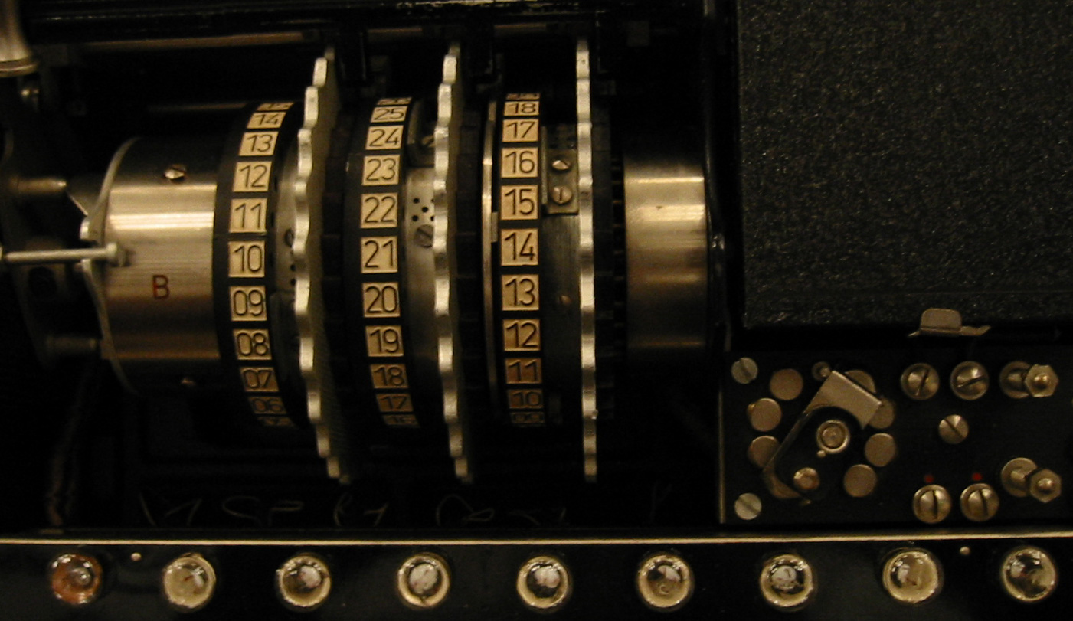
Enigma

Slide 12
Flaws of the Enigma
Letter could not encode to itself => negative fingerprint
Start position of the rotors were to be set randomly by operator => bias
Predictable cribs in the cipher “Wetterbericht” or “Heil Hitler”

Slide 13
Human bias in randomness
1010010011110011010111001011110101000111000100000001111000111100011100010100001101000010100001101111
101101101101010101010101011010101010101010101010101010101010101010101001101010011010101010101010101

Slide 14
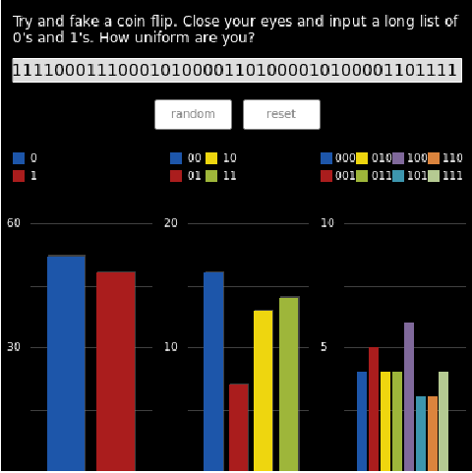
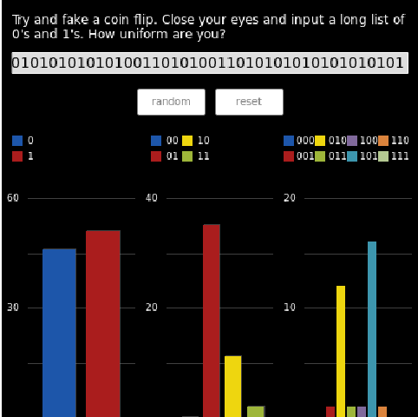
Frequency analysis:

Slide 15
Security by obscurity

Slide 16
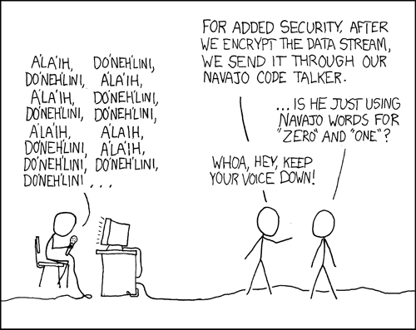

Slide 17
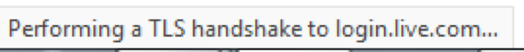
Asynchronous encryption and public keys
Public key to encipher
Private key to decipher
Based on complex mathematical functions
Easy to solve in one direction
Very difficult / impossible to solve the other direction

Slide 18
TLS -transport layer security
Public key comunication between server an dbrowser

Slide 19
Future challenges for asynchronous encryption
Based on complex mathematical problems
Never proven to be unbreakable
Just very difficult to break
Any moment a mathematician could come forward with a solution
Quantum computers might change everything

Slide 20
Quantum cryptography

Slide 21
What we saw:
Past of cryptography
Antique and Julius Caesar
Middle Ages, Vigenère, Al Kindi and letter frequency fingerprints
WW I and the Zimermann telegram
WW II, Nazis, the Enigma and how they screwed up
Cold war, Shannon and walnuts
Presence of cryptography
Open keys, asynchronous encryption and TLS
Future of cryptography
Breakthroughs in Mathematics and quantum computers

Slide 22
What I hope you have learned:
Cryptography didn‘t fall from the sky but evolved over the course of human history
Difference synchronous vs asynchronous encryption
The world might look quite different today if the Germans had used better encryption techniques.

